Slide 1
Bar Soap (Chemical Reaction) Product Defect Minimization &Production Process Optimization

Slide 2

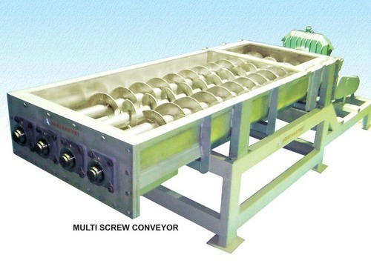
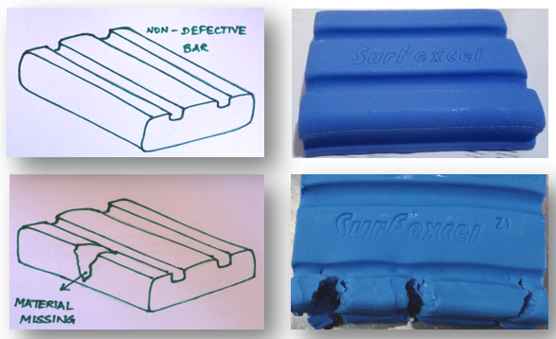
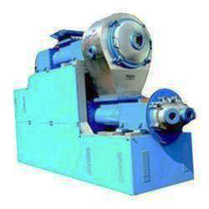
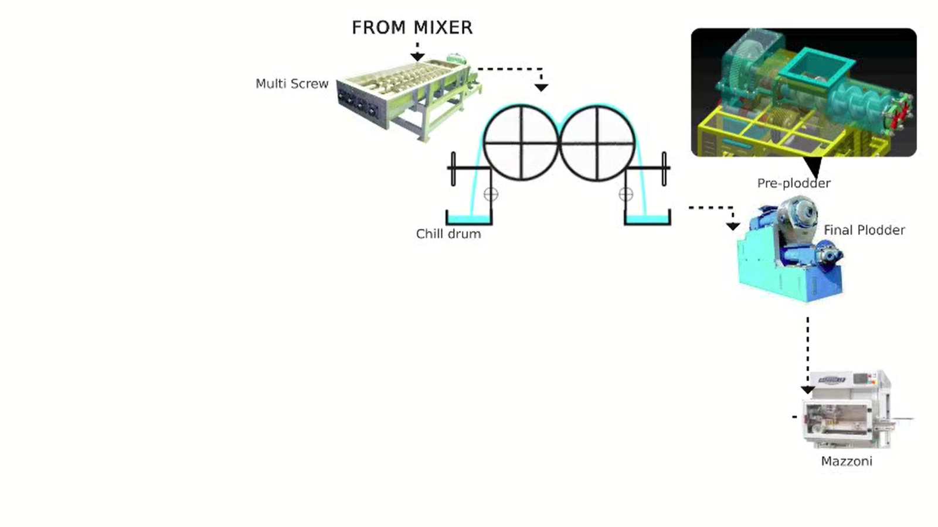
VARIABLES INFLUENCING Bar Soap
Batch making process
Batch RM input
Motor & Gear box
LIQUID RM QUALITY PARAMETERS
SOLID RM QUALITY PARAMETERS
RM DOSING QUANTITY
RM DOSING TIME
BATCH START TIME
BATCH STOP TIME
SODAL DAY TANK TEMP
DOSING TEMP
SPEED
CURRENT
VIBRATION
TEMPERATURE
Output parameters
PENETRATION VALUE (PV)
ACTIVE DETERGENT (AD)
TABLET TEMPERATURE
GRIT
WHITE PATCHES & BAR CRACKING
Mixer
Motor & Gear box
SPEED
CURRENT
VIBRATION
TEMPERATURE
Multi screw input
Multi screw
Multi screw hopper level
Chill drum input
Plodder input
Sparger inlet water pressure
Gap between drum
CD INLET WATER TEMP
CD Inlet water flow rate
CD OUTLET WATER TEMP
Chill drum blade pressure
NMB flake temperature
CD RPM
PLODDER VACUUM
PLODDER RPM
GAP BETWEEN WORM AND BARREL
PLODDER LEVEL
PLODDER INLET WATER TEMP
PLODDER OUTLET WATER TEMP
DIE TEMPERATURE
PLODDER VACUUM
Plodder
Motor & Gear box
Motor & Gear box
SPEED
CURRENT
VIBRATION
TEMPERATURE
SPEED
CURRENT
VIBRATION
TEMPERATURE

Slide 3



Data Science Approach
Descriptive
Predictive
Prescriptive
(Semi-Auto/ Auto)
Ready to Deploy
What is the overall trend?
Key Predictors
Validate assumptions
Validate technical concepts
Is there any pattern in the data?
Is there a function that can explain the process/data?
Is the prediction accurate?
Based on prediction values, is there a optimization model to suggest new set points for minimizing loss or variability?
These suggested set points are accurate and follow process safety/quality environment requirements?
Could suggested set points automatically drive process changes in a safe mode?

Slide 4
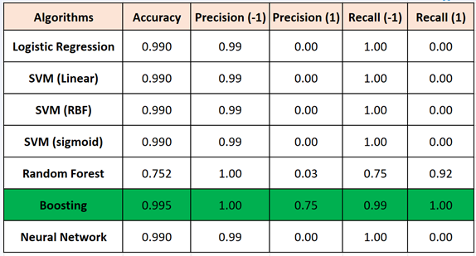
Prediction Modeling for Grit
Boosting has the best performance for each Mixer.
Best

Slide 5
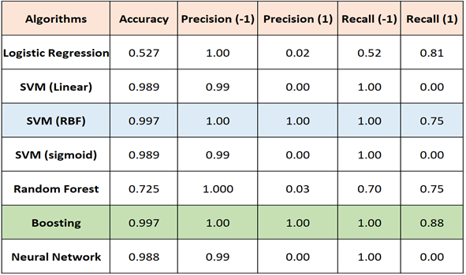
Predictive Modeling for Bar Crack
Best

Slide 6
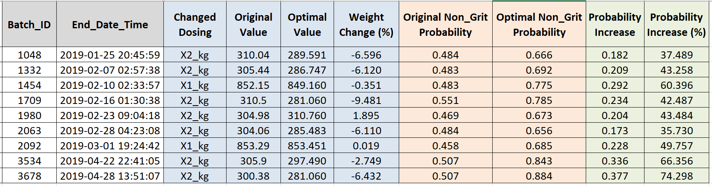
Prescriptive Recommendation for Grit
Significant increase!

Slide 7
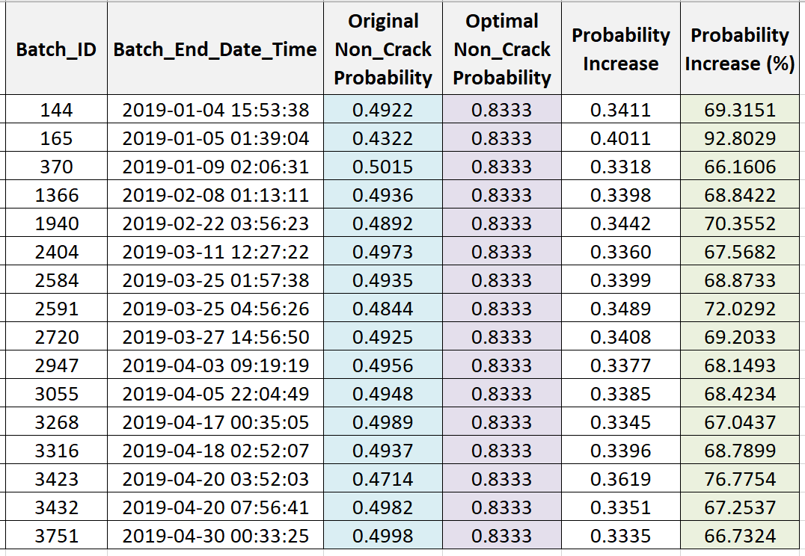
Prescriptive Recommendation for Crack:
.
Significant increase!

